Slide 1
VR/AR and Four Major Technical Problems to Solve
Ming Ouhyoung (歐陽明),
Dept. of Computer Science and Information Engineering, Former Chairman
Former Associate Dean, College of EECS
2017/9 updated

Slide 2
Outline
VR in Taiwan, 25 years of research
Academic progress: past and present
Industry progress: past and present

Slide 3
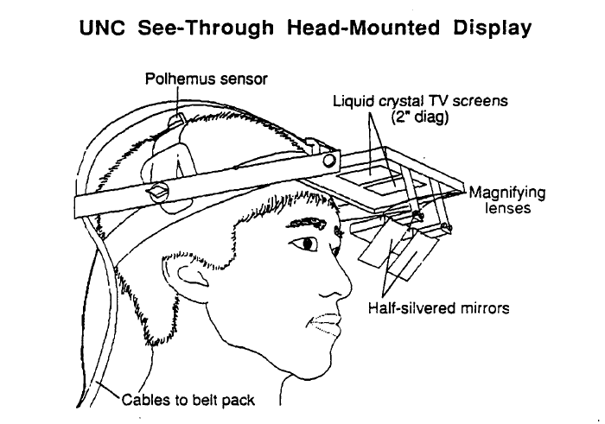
30 years from UNC HMD: very costly then! (Display, Sensors), 1988
Polhemus position/orientation sensor: US$2000, 25 years ago.
Display: LCD TV screens: US$400 per set, and need 2 of them!

Slide 4
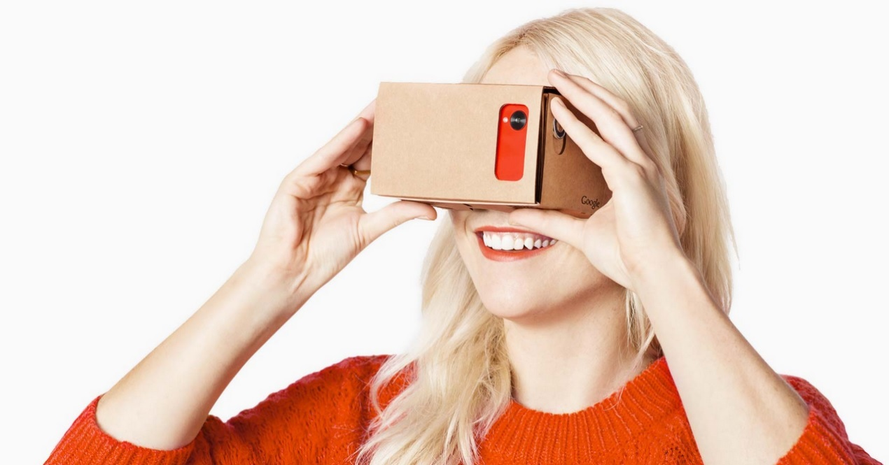
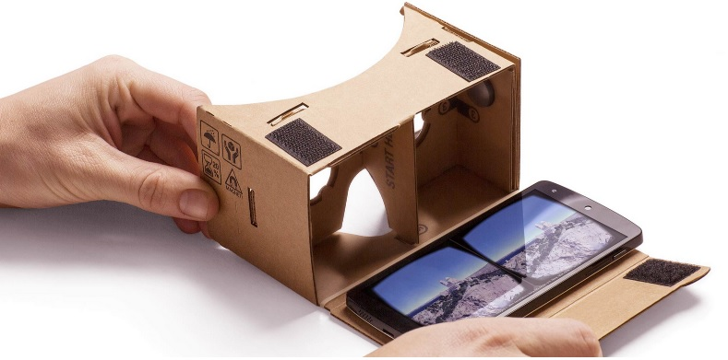
Google Cardboard VR, Extremely cheap HMD: US$6-20

Slide 5

VR in Taiwan (Academic): past and present, Early projects of Ming Ouhyoung
1995: NTU Panorama Tour with HMD
Video demo:
This is related to Google Street View now,
image stitching (50 plus photos in 1994, now
fisheye camera)
1995: Gesture Recognition for the hearing impaired, EuroGraphics’95
Video demo:
Related to Data Glove research, in HCI
Latency measurement and prediction compensation:
Building Walkthrough of CSIE Dept., 1995: video demo
Latency in 1995 (latency at 150ms) : video demo

Slide 6
Google Street View, and 360 Video
Related technology (earlier stage development)
1. Wen-Kae Tsao and Ming Ouhyoung, "An Alternative Approach of Rendering High Quality Images for Virtual Environments Using Scanned Images“, Proc. of RAMS'95 (Realtime and Multimedia Systems'95), pp. 71-78, Taipei, July 1995.
2. Ding-Yuen Chen, Ming Ouhyoung, “VideoVR: A real-time system for automatically constructing panoramic images from video clips”, pp. 140-143, Proc. IFIP 1998 Workshop on Modelling and Motion Capture Techniques for Virtual Environments (CAPTECH98), Geneva, Switzland, Nov. 1998.
360 video: video demo New York Marathon 2016

Slide 7
VR in Taiwan (Academic): present projects of Ming Ouhyoung
SCOPE+: (UIST 2015 Best Demo Award) Scope+ : A Stereoscopic Video See-Through Augmented Reality Microscope
video demo:
video demo (circuit board short demo):
catAR (Siggraph Asia 2016, VR Showcase)
video demo:
A Novel Dexterous Instrument Tracking System for Augmented Reality Cataract Surgery Training System
Talking Head: early stage (2004): video demo: tracking demo:
Emily project (with Alex Wan-Jun Ma, Paul Debevec)
video demo: Siggraph Asia 2008 (ACM TOG)

Slide 8
VR in Taiwan (Academic): projects of Ming Ouhyoung
3D DDR (Dance Dance Revolution), Siggraph 2006 Emerging Tech
video demo:
Related to Microsoft Kinect development

Slide 9
VR in Taiwan (Academic): past and present current projects of Yi-Ping Hung
Dun-Huang Cave project: (“Teleport”)
video demo: (with iPad, and with HTC Vive)
ImTop project: Desktop (Stereo)
video demo:

Slide 10
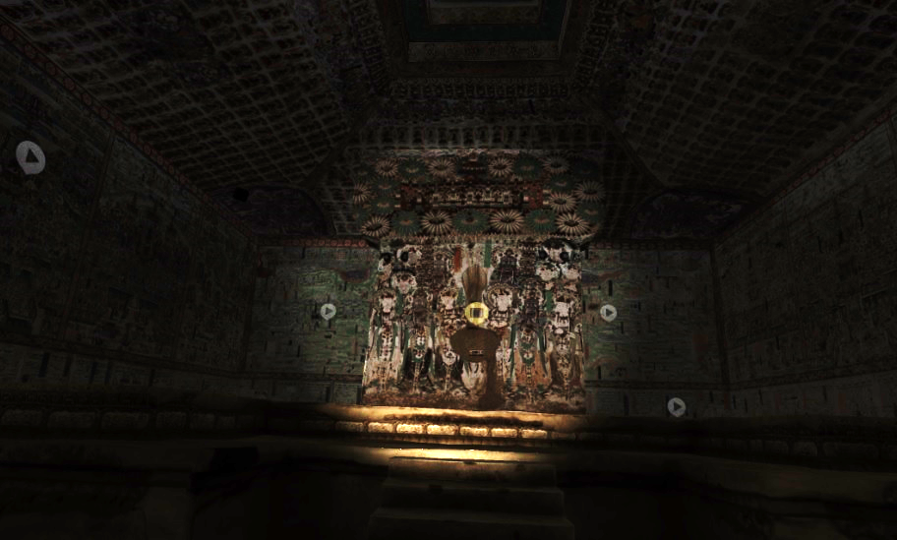
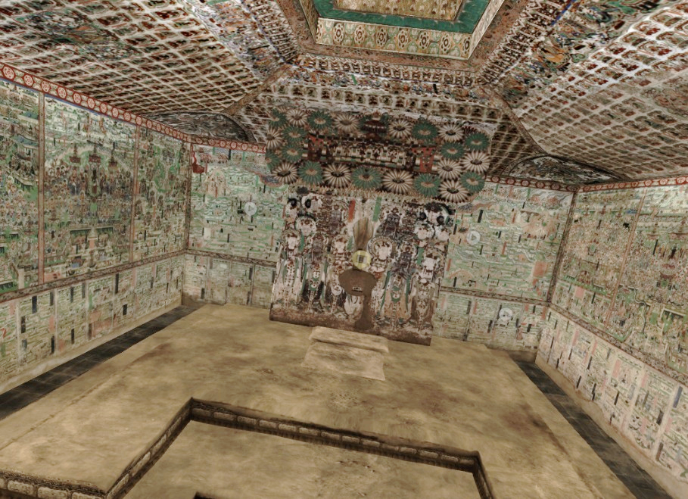
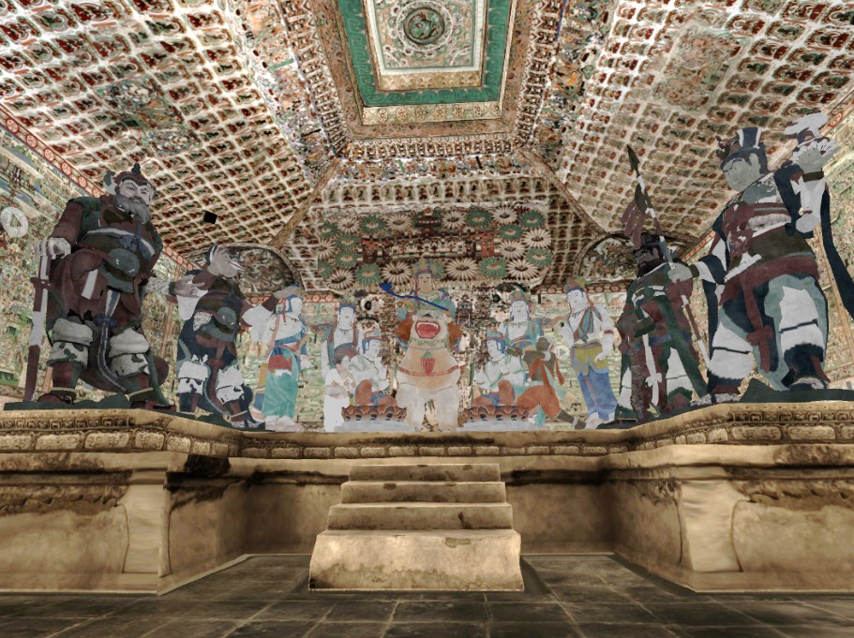
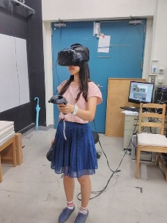
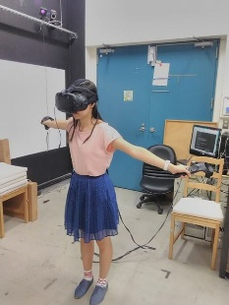
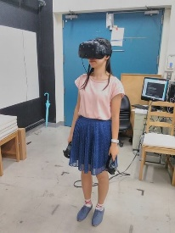
Dun-Huang Cave VR Tour (神遊敦煌) Immersive Display
Flash light mode:
focusing
Flying mode
Interact with
Reconstructed
Cave statute

Slide 11
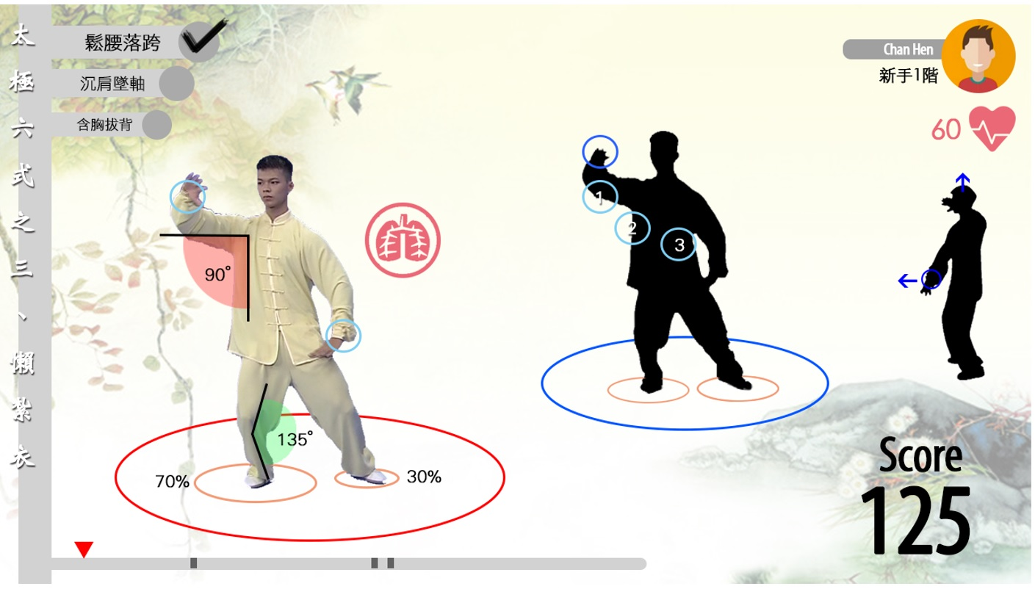
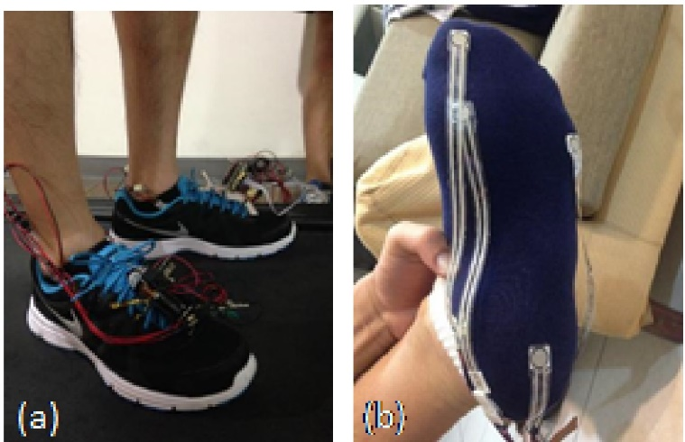
Project: Immersive Networking Environment for Personal Physical Training Based on Hybrid Internet Broadcast TV: Using Chinese Martial Art Taichi as an Example
Ming Ouhyoung, with Yi-Ping Hung, and three other faculty members

Slide 12
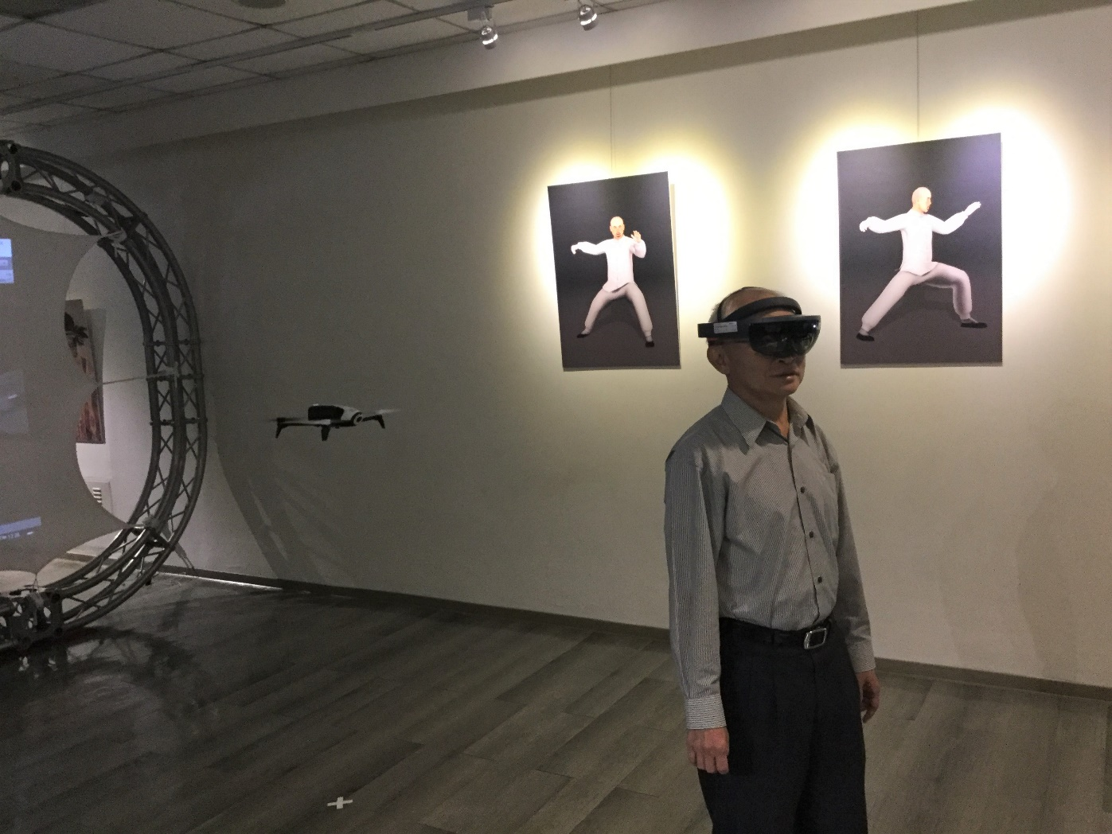
Playing Tai-Chi, a Chinese Martial Art

Slide 13
HCI in Taiwan (Academic): past and present current projects of Robin Chen, Mike Chen, Hao-Chu, Liwei Chan
CHI 2013 – Nail Display- Bringing an Always-Available Visual Display to Fingertips, (Best Paper Award, CHI2013)
video demo: Nail DIsplay
video demo: Touch Sense
video demo: Finger Pad (Private and Subtle)

Slide 14
Industry progress: past and present
Reallusion Inc. (甲尚科技)
Talking Head: video demo
Full-Body animation: (iClone5, Tai-Chi practice video demo)

Slide 15
Industry progress: past and present IGS Inc. (International Games System,鈊象電子)
Arcade game,
Racing Cars
Dancing, video demo

Slide 16
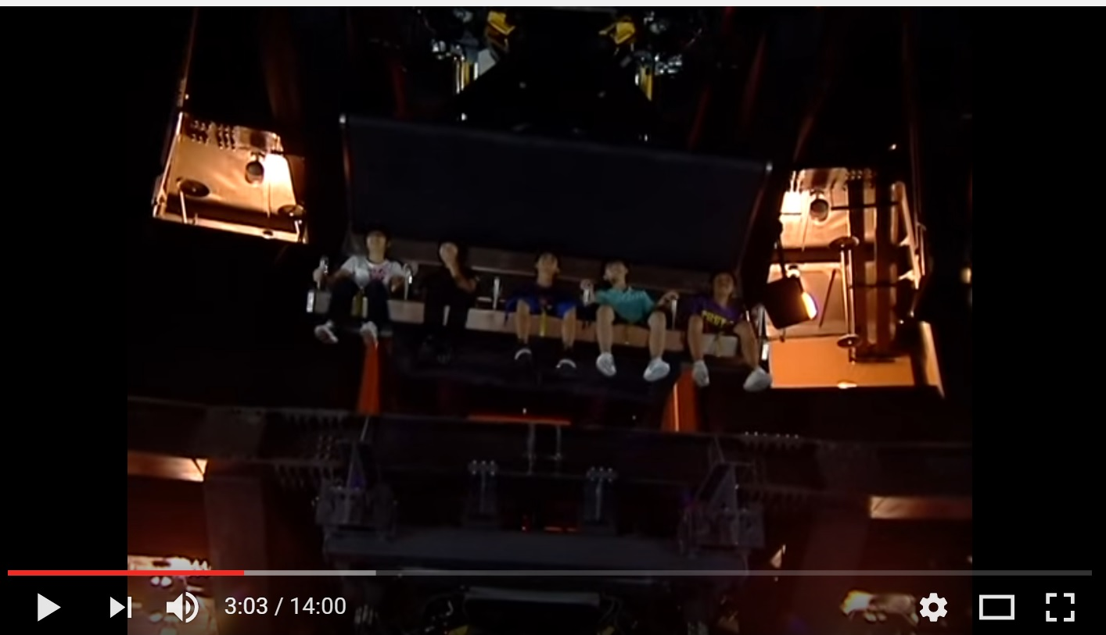
Theme Park (I-Da World, 義大世界) , 活躍動感INC.
VR motion platform, FlyOver Canada project, video demo

Slide 17
It seems that VR/AR is just going through the Cambrian explosion! (寒武紀大爆發)
Google glass (failed product)
Oculus Rift/Rift 2 (purchased by Facebook)
Google Cardboard VR project
Magic Leap secures 542M by Google Inc.
Microsoft HoloLens project
all these happened in 2014/2015!

Slide 18
Four major problems in VR/AR
1. Display resolution: wide angle display, without seeing pixels in display
2.Latency: should be less than 20 to 50ms
If greater than 50 to 100 ms, will cause dizziness, even nausea.
3.fixed focus vs. variable focus in observation through HMD or others.
4.Registration of real objects and virtual environments in AR

Slide 19
Google Cardboard VR, Extremely cheap HMD: US$6-20

Slide 20
Half a million sold in one week! (December 16, 2014 news)
Less than a week after going on sale and dropping rather quietly on an unsuspecting America, Project Cardboard has rocketed past the 500,000 sales mark. Such is the popularity of the DIY virtual reality toy that Google has even built and launched a dedicated area of the Play Store for apps created for or ideally suited for use with the unusual piece of facewear.

Slide 21
Why so popular?
“The growth of mobile, and the acceleration of open platforms like Android make it an especially exciting time for VR,” beamed Andrew Nartker, project manager for Google Cardboard.

Slide 22
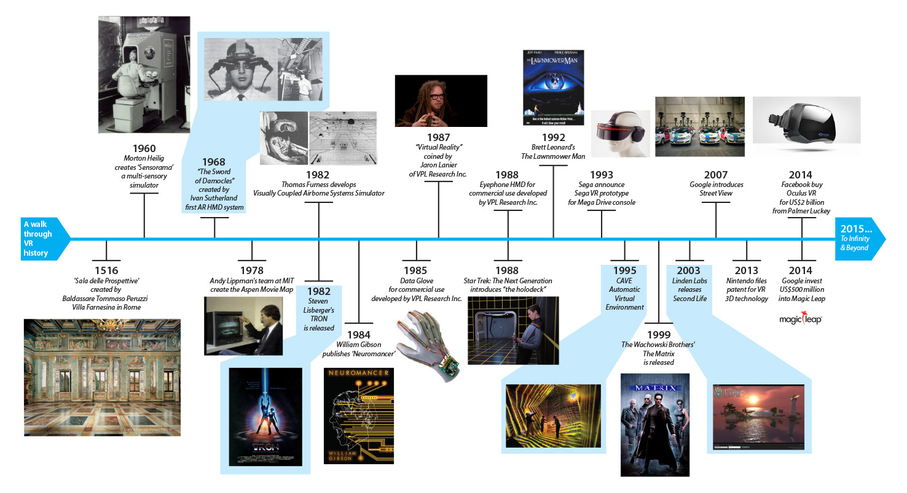
VR In Retrospect. 57 years of history since 1960
From James Hsu, Acer Inc. (and the following 4 slides)

Slide 23
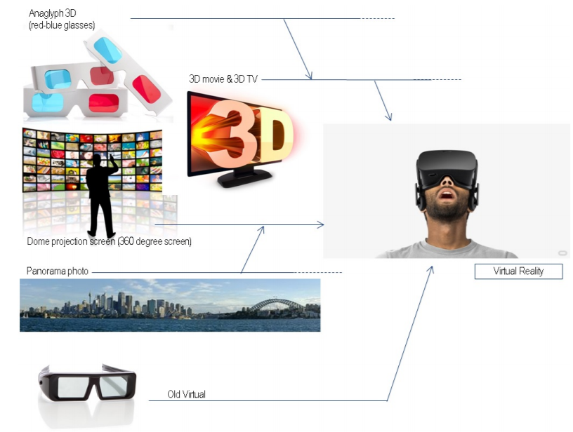
VR Is The Integration Of Modern Visual Technology

Slide 24
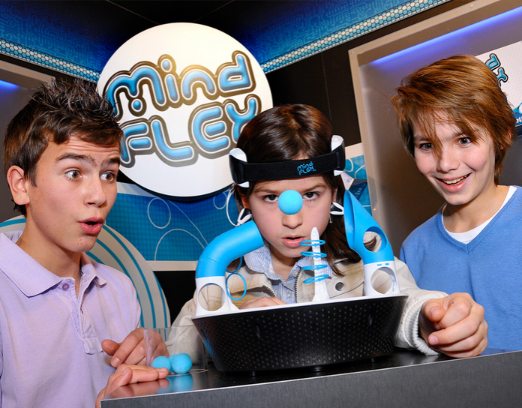
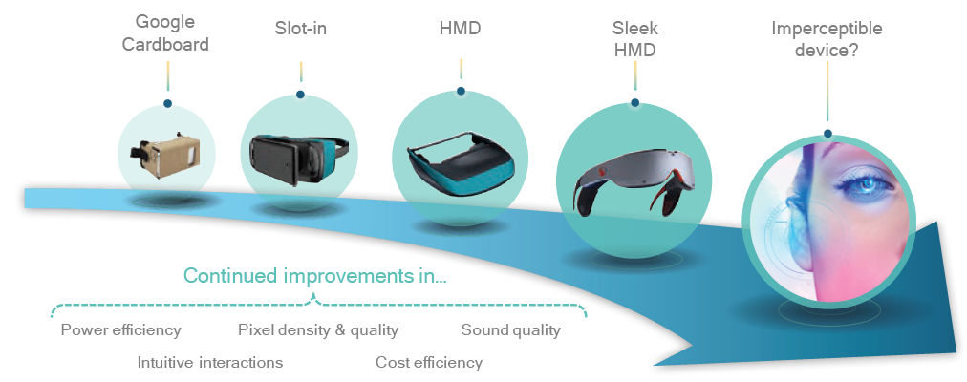
VR Device Evolution

Slide 25
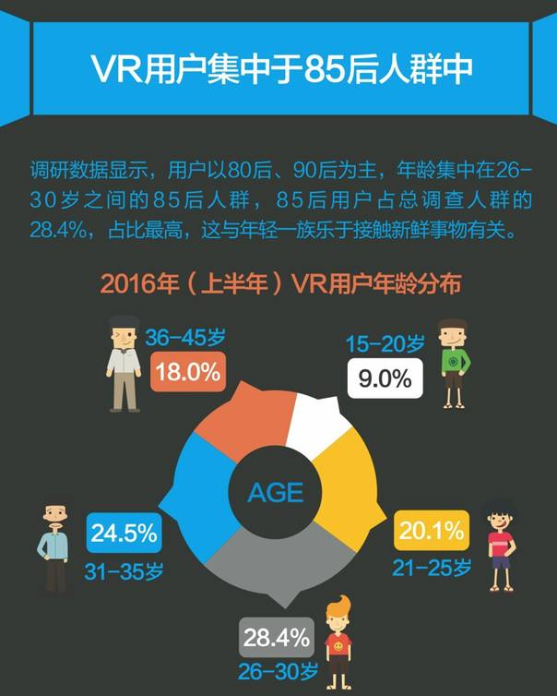
Target Segments

Slide 26
HR
Gaming
Social
Storytelling
Retail
Military
Education
Multimedia
Journalism
Finance
Medical
Tourism
Maker
Toy
Surgery Training
Fashion
Marketing
3D Printing
Robotics
Real Estate
VR Can Be Virtually Applied In EVERY Business
Mechanical Engineering
Psychology
Art
Product Design
Therapy
Simulator
Live Event
eCommerce
Automobile
Museum
Filming
Engineering
Manufacturing
Sports
Aerospace
Entertainment
Architecture

Slide 27
Pixel phone, Latency issues
Pixel Phone: first certified Day Dream project phone,
The first Google phones to compare with Apple’s iPhone 7.
How good is the latency?
You tube: Keyword: latency pixel, video demo
The video shows a scene from Google Street, and I am rotating the phone at around 4 times (250ms) per second. The latency (from motion to display latency is obvious, perhaps can be estimated to be as long as 50ms to 100ms).
Comparison: HTC m9+
You tube: Keyword: latency m9+ video demo:
The video shows a scene from Google Street, and I am rotating the phone at around 4 times (250ms) per second. The latency (from motion to display latency is obvious, perhaps can be estimated to be as long as 50ms to 100ms).

Slide 28
The latency in 1994 NTU Building Walkthrough project
Latency:
Video from You Tube: Key word “latency 1994 NTU building walkthrough”, video demo
In 1994, the Polhemus tracker (for head motion tracking) plus the Silicon Graphics workstation (foir graphics display, then the most powerful graphics engine).
The estimated latency is around 150ms to 200ms, depending on the graphics complexity of content, and can be reduced to 70ms by software latency compensation.

Slide 29
Resolution issues in VR headset
BOBO VR (小宅 Z3, Z4)
VR Box
Google Cardboard VR, version 2 (improved).
HTC VIVE
With 2560 resolution, the best you can get from Google Pixel XL,
and from HTC M9+ (with MTK Helio X10),
The best viewer (not to see pixels in display) is for viewers with a FOV less than 90 degrees, better from 60 degrees. Therefore, BOBO VR (小宅 Z3), VR Box is the ebst to show 360 video and Google Street content.
Be careful, BOBO VR (小宅 Z4), HTC VIVE, and Google Cardboard VR (version 2), being able to show 100 to 120 degrees FOV, will see clear pixels in content.
(Although experts insist that large FOV is important for “Immersive Display”).

Slide 30
Resolution Problem: not to see pixels What is the best resolution in display in HMD?
For example, for mobile device display:
For Google Cardboard VR HMD, if the field of view (angle) is 60 degrees, the required screen resolution is around 5700x5700,
For Oculus Rift2/Gear VR, or HTC Vive, the filed of view is 90-110 degrees, the required resolution should be 10Kx10K !
(Because in visual acuity: eye’s ability to distinguish two points of light is limited to 1.5 – 2.0 mm at a distance of 10 meters. (or 2 microns on the retina)).

Slide 31
Google Pixel Phone
Pixel XL: 5.5-inch 2560 x 1440 resolution looks super crisp, OLED screen
Pixel: smaller phone sacrifices display resolution (1920 x 1080).
It starts at $649 for a 32GB Pixel and goes up to $869 for the larger 128GB Pixel XL.
The 12-megapixel camera is fast and Google claims it’s great in low-light. It got a DxOMark camera score of 89 — the best score ever given out to a phone.
Google also finally reworked some of the systems behind touch responsiveness on the display. Dave Burke, VP of engineering for Android, says that "touch latency [on the Pixel] is the best of any Android device ever produced. If you put it under high-speed camera, it’s on par with an iPhone." (It still feels a little different to me, mainly because Android handles inertia a little differently than iOS).

Slide 32
Details like latency are precisely the kind of things that get better when you control the "end-to-end" experience. But where Google’s new "opinionated" approach really comes to the fore is in the software. The Pixel is the first (and, for now, the only) phone to support the new Pixel home screen, Daydream virtual reality, and the Google Assistant.
Daydream app: The hub of Google VR Daydream app for Android only, not iOS When you open the Daydream app (without slotting it into View), you'll see featured apps and recommendations. It's like the hub of Google VR.

Slide 33
Latency Compensation
Jiann-Rong Wu and Ming Ouhyoung, "On Latency Compensation and its Effects for Head Motion Trajectories in Virtual Environments," The Visual Computer, vol. 16, no. 2, pp. 79—90, 2000.
Azuma R, Bishop G (1994) Improving static and dynamic registration in an optical see-through HMD. SIGGRAPH’94 Conference Proceedings,
Jiann-Rong Wu and Ming Ouhyoung, "A 3D Tracking Experiment on Latency and Its Compensation Methods in Virtual Environments", Proc. of UIST'95 (User Interface and Software Technoilogy 1995), pp. 41-49, ACM Press Pittsburgh, USA

Slide 34
One of the critical problems is the perceived latency [12], or lag. This is the time delay from the user’s input action until the response becomes available for display.
the illusion of a virtual world is destroyed if the objects on the screen jitter signiﬁcantly while the head is not in motion – the “swimming effect”
Major components of end-to-end latency include (1) the time for internal processing by input sensors,(2) data transfer from the sensorsto the host computer, (3) update of the physical simulation output by applications in response to user input, and (4) image rendering and display.

Slide 35
Azuma and Bishop [1] used Kalman ﬁltering with inertial sensors mounted on a see-through HMD to improve the dynamic registration, that is, to reduce the latency.
The result can signiﬁcantly aid the head-motion prediction in real cases; on the average, prediction with inertial sensors produces two to three times less errors than that of prediction without inertial sensors, and ﬁve to ten times less than that of using no prediction at all.
However, at bigger latency (more than 130 ms), the prediction accuracy, with or without the use of inertial sensor in Kalman ﬁltering, is not signiﬁcantly different

Slide 36
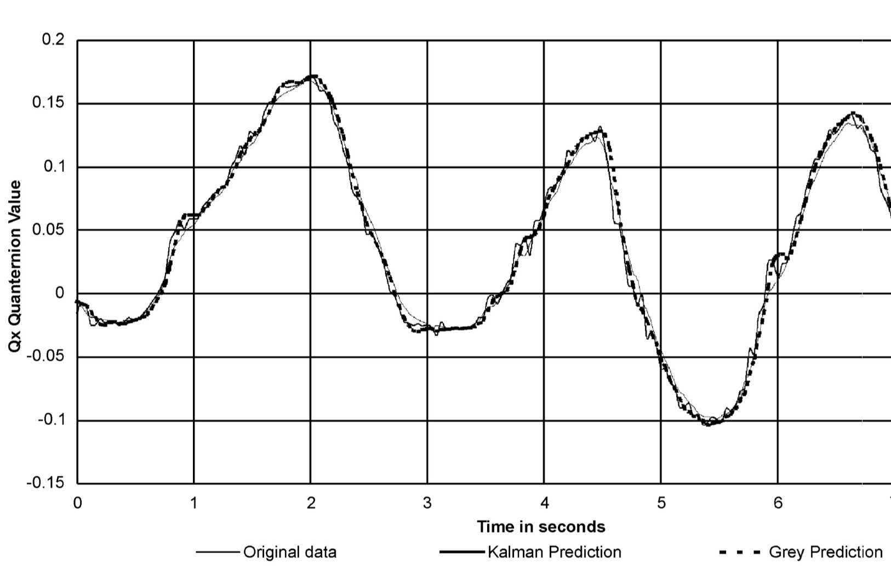
Plot of quaternion curve Qx (quaternion) with Kalman prediction without inertial sensor versus grey system prediction

Slide 37
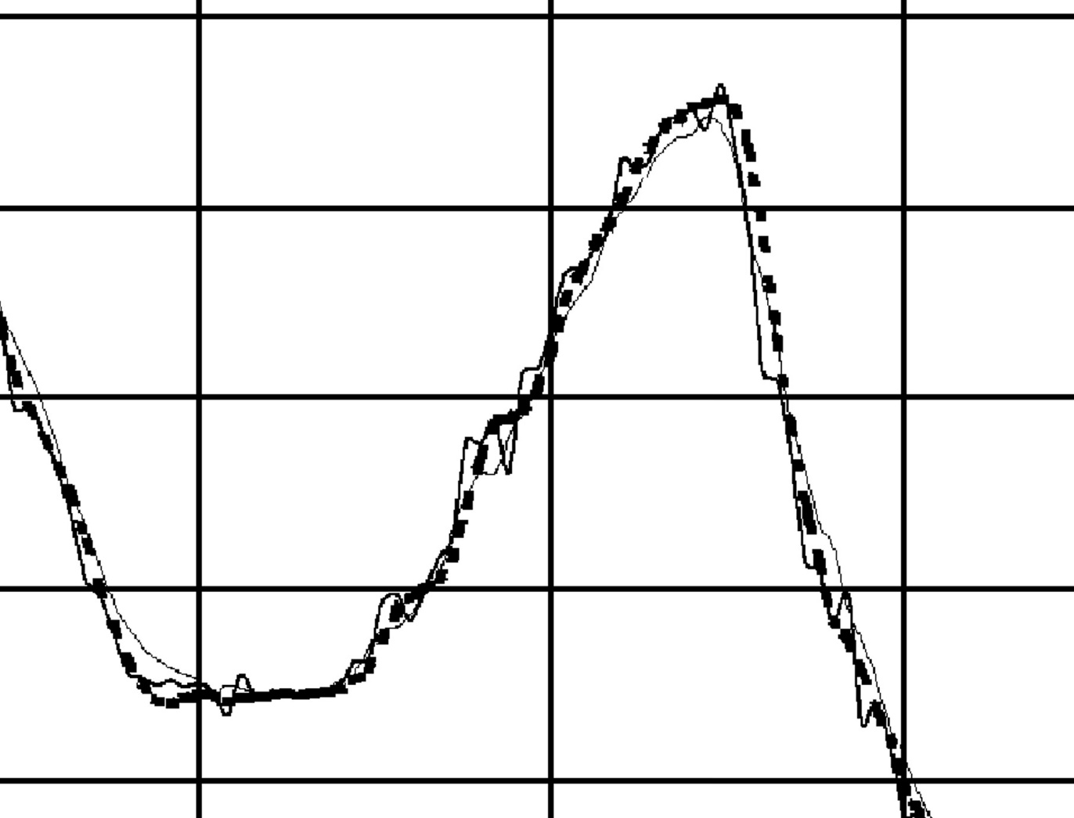
Motion curve with latency compensation: Blow up figure

Slide 38
From Motion to Photons in 80 Microseconds: Towards Minimal Latency for Virtual and Augmented Reality, 2015 IEEE Trans. On Visulization & CG
by Peter Lincoln, Alex Blate, Montek Singh, Turner Whitted, Andrei State, Anselmo Lastra, and Henry Fuchs

Slide 39
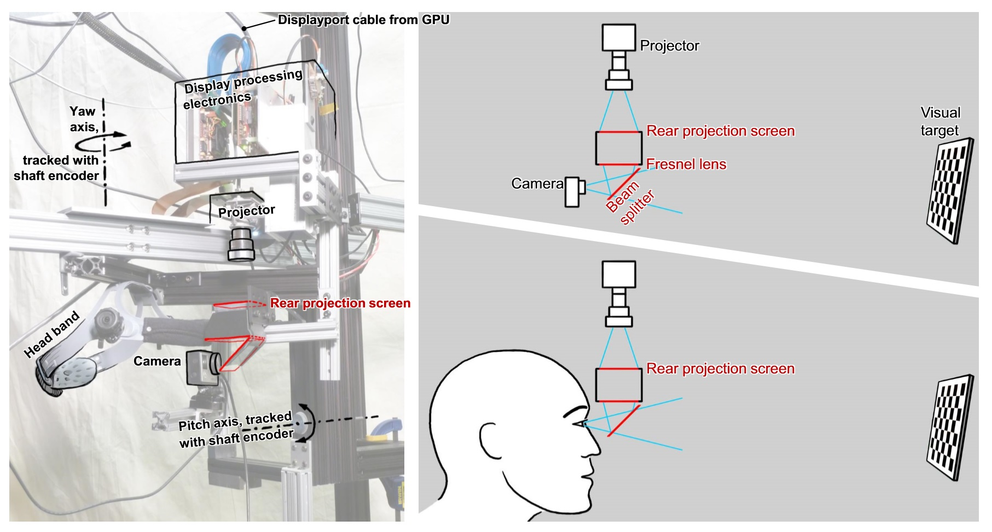
How to measure latency?

Slide 40
A simple method: video demo
Video from Totoro’s recording, the HMD motion, and its’ recording
(in NTU, old office computer, go get it).

Slide 41
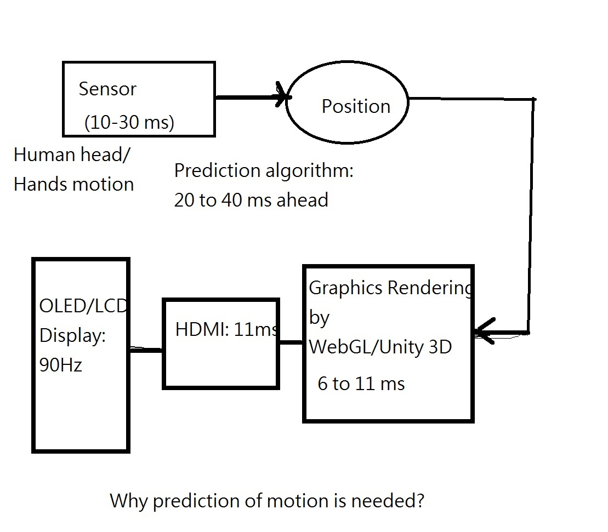
Reducing the latency: Prediction (by Kalmann Filter, for example, for 20-40 ms prediction of head/hand motion)
Occulus as well as HTC Vive

Slide 42
the update rate can reach 15–20 frames/s on an SGI Indigo2 Extreme graphics workstation. Even though the update rate is enough to work with, it still has an overall latency of about 300 ms. The tracker contributes approximately 70 ms; the rendering pipeline, 80 ms; and the LCDs with relatively low refresh rates in the HMD contributes 150 ms. Currently, the system can be operated by three kinds of input/output devices (1) the 3D tracker to an HMD, (2) the external buttons for left and right turn, and (3) a shaft encoderbased treadmill system for measuring the walking speed.

Slide 43

How to verify if VR/AR is useful? (How Real?)
Fred Brooks, ACM Siggraph 2002
Observation: Skin conductance, respiration, heart beat rate.
Meehan, M., B. Insko, M.C. Whitton, F.P. Brooks Jr., 2002: "Physiological Measures of Presence in Stressful Virtual Environments," ACM Transactions on Graphics, 21, 3: 645-652. (Proc. of ACM SIGGRAPH 2002, San Antonio, TX).

Slide 44
We hypothesized that to the degree that a VE seems real, it would evoke physiological responses similar to those evoked by the corresponding real environment, and that greater presence would evoke a greater response.

Slide 45
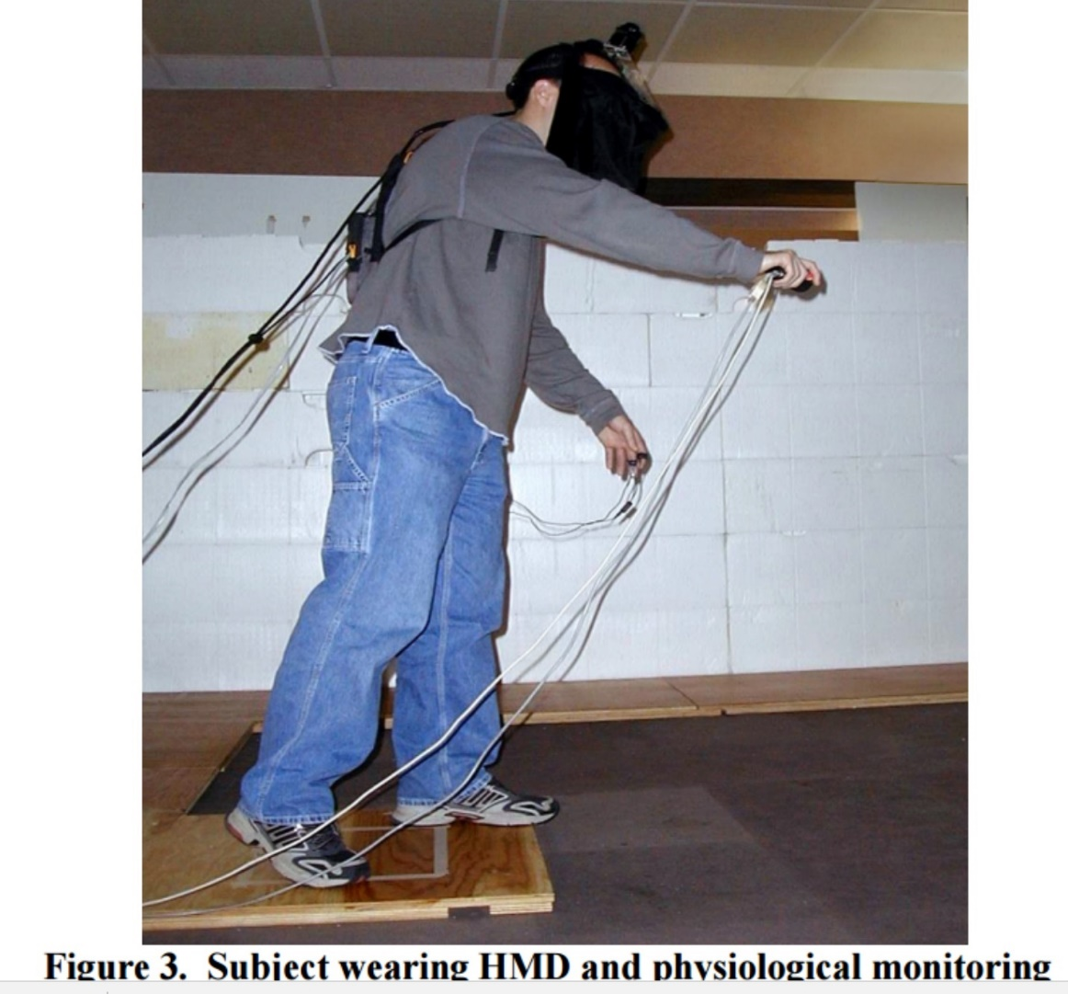
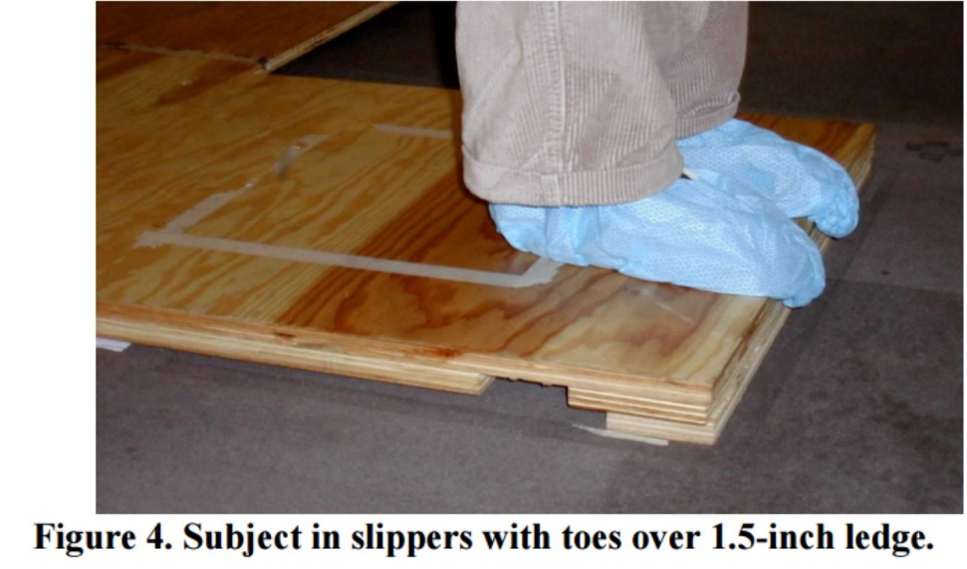


Set up: with an edge, 1.5 inch thick

Slide 46
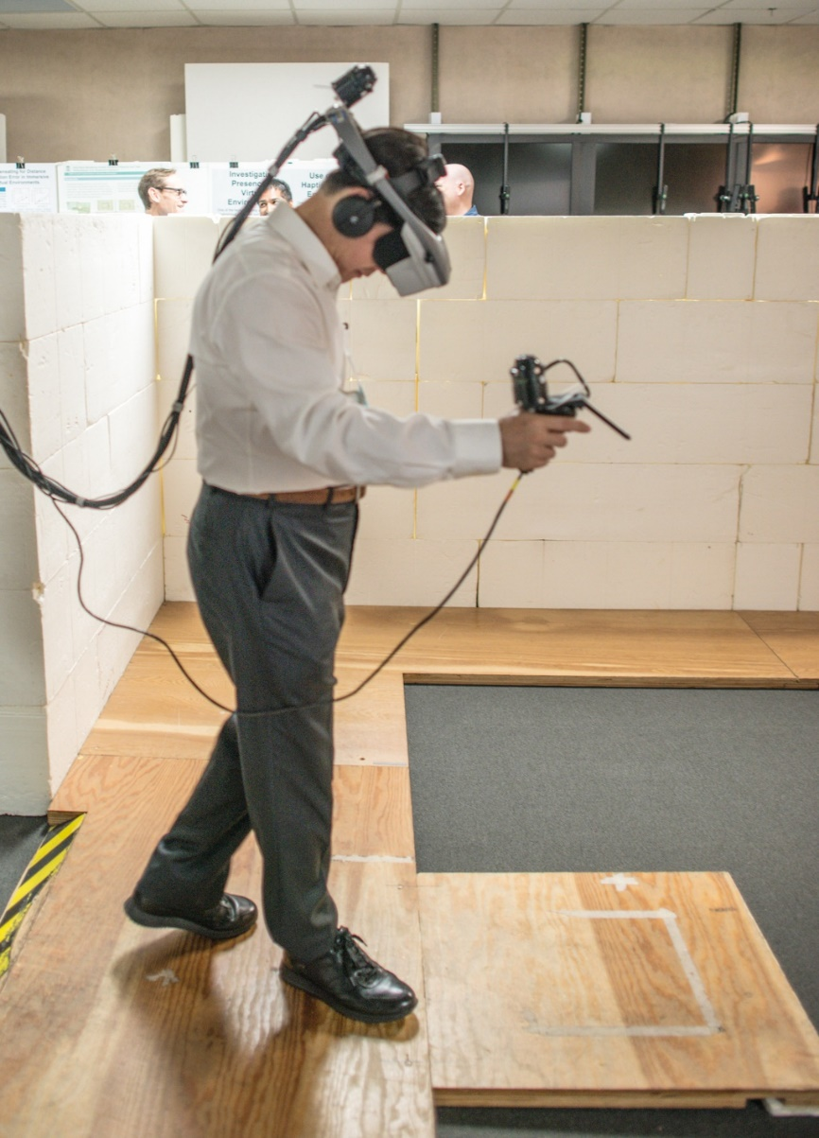
Physiological Measures of Presence: I was at UNC-CH, 2015, playing it.

Slide 47
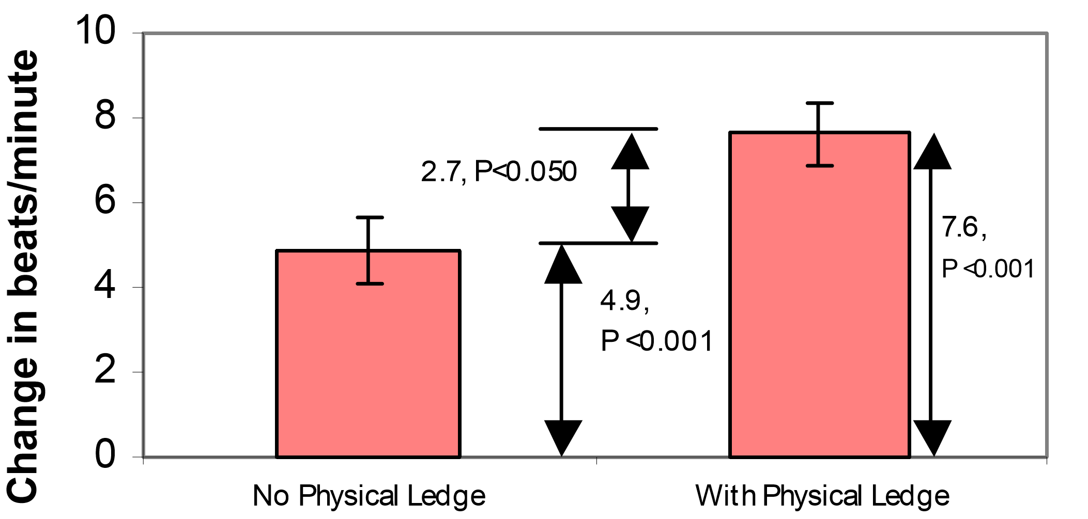
Heart Rate Changes: without vs. with an edge

Slide 48
Experimental Results
We found that change in heart rate satisfied our requirements for a measure of presence, change in skin conductance did to a lesser extent, and that change in skin temperature did not. Moreover, the results showed that inclusion of a passive haptic element in the VE significantly increased presence and that for presence evoked: 30FPS > 20FPS > 15FPS.

Slide 49
fixed focus vs. variable focus):
(Fu-Chung Huang, NTU BA)
"The Light Field Stereoscope: Immersive Computer Graphics via Factored Near-Eye Light Field Display with Focus Cues", Fu-Chung Huang, Kevin Chen, and Gordon Wetzstein, Youtube Link ACM SIGGRAPH 2015, Los Angeles (see some press coverage below)
"Eyeglasses-free Display: Towards Correcting Visual Aberrations with Computational Light Field Displays", Fu-Chung Huang, Gordon Wietzstein, Brian Barsky, and Ramesh Raskar, - 10 World Changing Ideas 2014, Scientific American ACM SIGGRAPH 2014, Vancouver (see some press coverage below)

Slide 50
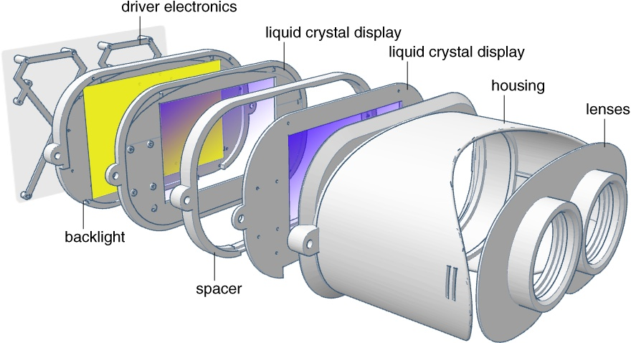
Innovation: vergence-accommodation conflict inherent to all stereoscopic displays

Slide 51
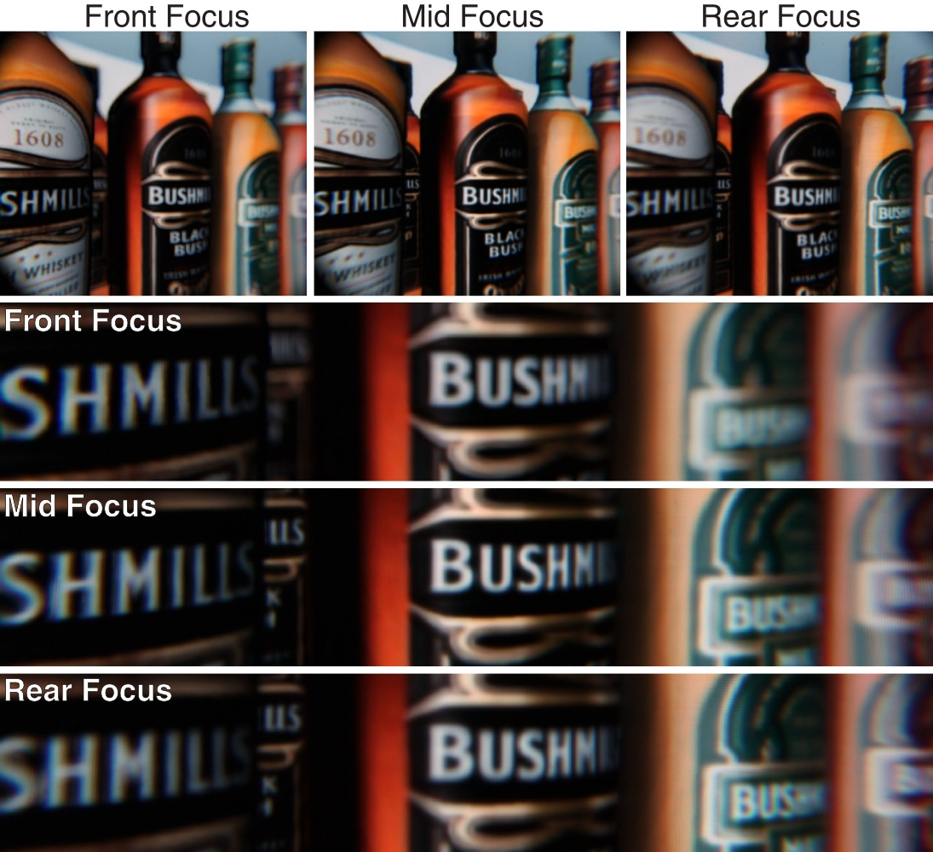
near, middle range,far, three focuses

Slide 52
What is the best resolution in display? Problem 1: 視覺解析度 display resolution:
For example, for mobile device display:
For Google Cardboard VR HMD, if the field of view (angle) is 60 degrees, the required screen resolution is around 5700x5700,
As in Oculus Gear VR, or HTC Vive, the filed of view is 90 degrees or above, the required resolution should be 10Kx10K !
(Because in visual acuity: eye’s ability to distinguish two points of light is limited to 1.5 – 2.0 mm at a distance of 10 meters. (or 2 microns on the retina)).

Slide 53
New type of display, other than LCD and OLED.
Playnitrade Inc. (李允立)
can possibly provide a display of resolution 10Kx10K in a few years.
Semiconductor components for laser diodes (LD) , more density, brighter, and 85% efficiency in energy consumption.
(UV-LED)
LCD has a energy efficiency of 5% only, while OLED is about 35%.

Slide 54
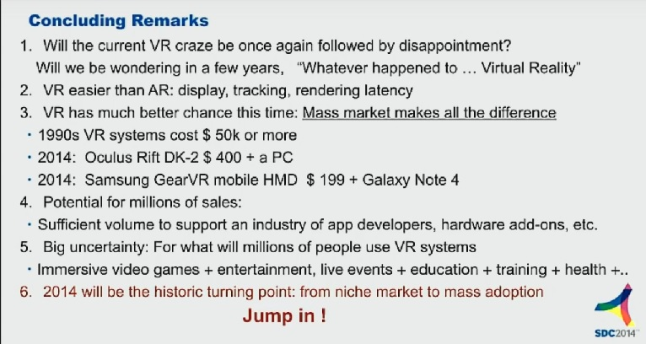
Estimation in SDC 2014

Slide 55
END
More to see:
Docomo Vision 2020
MicroSoft’s Concept: Future Vision 2020
Samsung’s vision: display

Slide 56
END

Slide 57
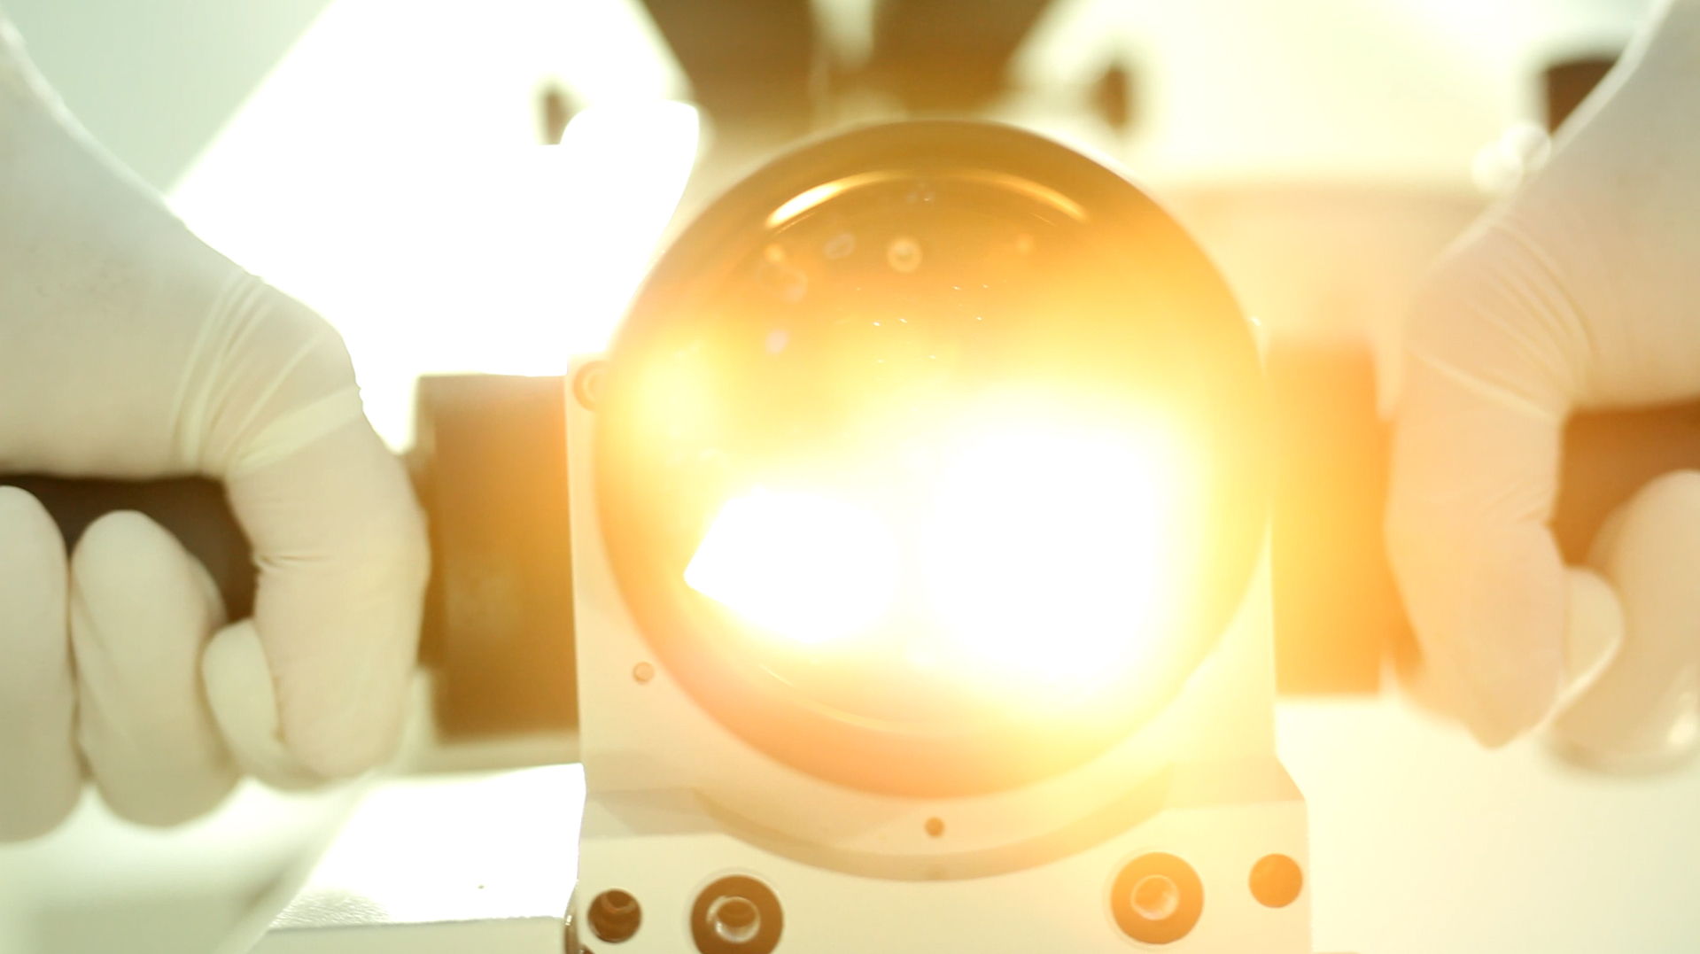


A Stereoscopic Video See-Through Augmented Reality Microscope
Yu-Hsuan Huang
Tzu-Chieh Yu
Pei-Hsuan Tsai
Yu-Xiang Wang
Wan-Ling Yang
歐陽明(Ming Ouhyoung)
National Taiwan University

